Slide 1

CSE (H) with specialization in Machine Learning and Artificial Intelligence
Soft Computing (CSF – 332)
Chapter -2.2
Neural Network Optimization Methods
By: Dr. Monika Singh E11032
DISCOVER . LEARN . EMPOWER

Slide 2
Course Objectives
To introduce soft computing concepts and techniques of artificial neural networks, fuzzy sets, fuzzy logic and genetic algorithms
To understand the various techniques from the application point of view.
To analyze various soft computing techniques and decide the technique to be used in a particular problem situation.
To implement soft computing based solutions for real-world problems

Slide 3
Course Outcomes
CO1 | Identify and describe soft computing techniques and their roles in building intelligent. Machines | 1
CO2 | Recognize the feasibility of applying a soft computing methodology for a particular problem. | 2,4
CO3 | Apply fuzzy logic and reasoning to handle uncertainty and solve engineering problems, genetic algorithms to combinatorial optimization problems and neural networks to pattern classification and regression problems. | 3
CO4 | Effectively use modern software tools to solve real problems using a soft computing approach. | 3
CO5 | Evaluate various soft computing approaches for a given problem. | 4

Slide 4
Table of Contents
Loss functions and optimization
Cross entropy loss
Activation function

Slide 5
Neural Network Optimization Methods

Slide 6
Introduction to loss functions
The output of a network or from Activation Functions sometime becomes meaningless without efficient evaluation.
Before listing some functions that might become your ‘finance’ in the future, I want to notice you that there is not a single Loss Function that works for all kind of data.
It depends on a number of factors including the presence of outliers, algorithm, time efficiency of gradient descent, ease of finding the derivatives and confidence of predictions… or maybe an accident.

Slide 7
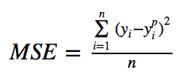
Mean squared error (MSE)
It is the most commonly used regression loss function. As the name suggests, Mean square error is measured as the average of squared difference between predictions and actual observations. It’s only concerned with the average magnitude of error irrespective of their direction. However, due to squaring, predictions which are far away from actual values are penalized heavily in comparison to less deviated predictions.
Mean Square Error (MSE/ L2 Loss)
Below is a plot of an MSE function where the true target value is 100, and the predicted values range between -10,000 to 10,000. The MSE loss (Y-axis) reaches its minimum value at prediction (X-axis) = 100. The range is 0 to ∞.

Slide 8
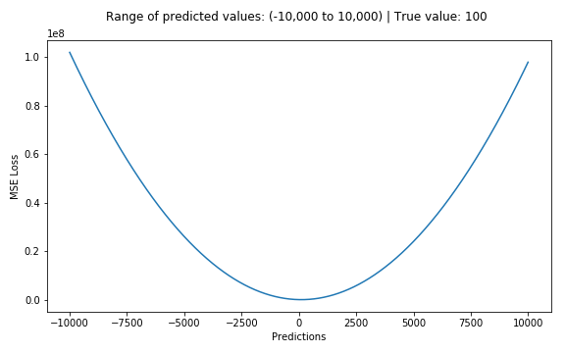
Continue:

Slide 9

Mean Absolute Error (MAE)
It is another loss function used for regression models. MAE is the sum of absolute differences between our target and predicted variables. So it measures the average magnitude of errors in a set of predictions, without considering their directions. (If we consider directions also, that would be called Mean Bias Error (MBE), which is a sum of residuals/errors). The range is also 0 to ∞.
Mean Absolute Error (MAE/ L1 loss)

Slide 10
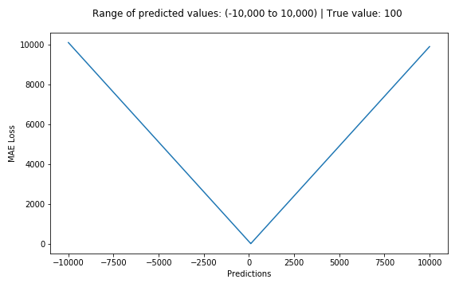
Continue:

Slide 11

Huber or smooth mean absolute error
Is less sensitive to outliers in data than the squared error loss. It’s also differentiable at 0. It’s basically absolute error, which becomes quadratic when error is small. How small that error has to be to make it quadratic depends on a hyper-parameter, 𝛿 (delta), which can be tuned. Huber loss approaches MAE when 𝛿 ~ 0 and MSE when 𝛿 ~ ∞ (large numbers.)
However, the problem with Huber loss is that we might need to train hyper-parameter delta which is an iterative process.

Slide 12
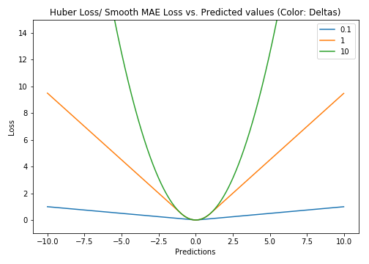
Continue:

Slide 13

Log-Cosh Loss
Log-cosh is another function used in regression tasks that’s smoother than L2. Log-cosh is the logarithm of the hyperbolic cosine of the prediction error.

Slide 14
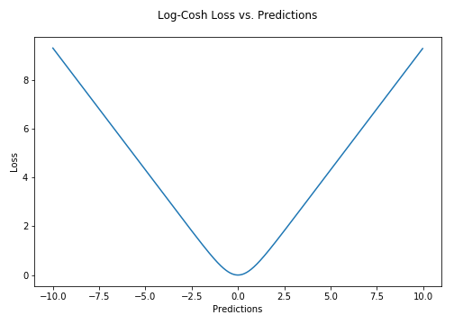
Continue:

Slide 15
Summary
Requirement of loss functions is being discussed. There are two categories of loss function, i.e., classification loss and regression loss. Regression loss is discussed.

Slide 16
Questions…
What do mean by regression loss functions?
What is the difference between MSE and MAE
What do you understand by log cosh loss?

Slide 17

References
Book:
S.N.Sivanandam, S.N Deepa, “Principles of Soft Computing”
Websites:
https://nptel.ac.in/courses/106/105/106105173/
Videos:
https://www.youtube.com/watch?v=mlfM4SGOAgo

Slide 18
THANK YOU
For queries
Email: monika.e11032@cumail.in

